Slide 1
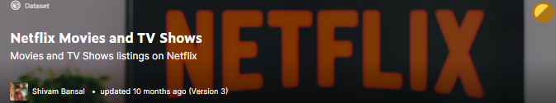
The era of Netflix Project team: Ahmad Abo Alafa Loic Tiemani Hazim Hamadne Hamid Zarringhalam

Slide 2
Purpose of the Project
This Project is the continuation of Project-2 which was about Netflix Movies and TV-Series Data Analysis. The purpose of this project is to provide users an interactive means to explore Netflix data.
Tasks:
The tasks for this project includes:
1. Create Github repository and integrate it with Salesforce Heroku
2. Reading the data from the Azure PostgreSQL Database
3. Publish the data into the Index.html template using Flask
4. Using js, d3 and plotly to visualize the data as required

Slide 3
Specific requirements
. Visualization include a Python Flask–powered API, HTML/CSS, JavaScript, and
PostgreSQL database.
https://netflix-proj-3.herokuapp.com/
. The project fall into the below tracks:
○ A custom “creative” D3.js project.
○ A dashboard page with multiple charts that update from the same
data
○ Perform multiple manipulations on data in a database prior to
visualization.

Slide 4
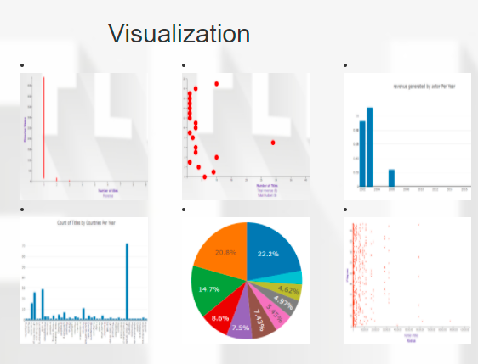
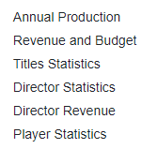
Specific requirements
The project include Eight (8) JS libraries.
These libraries contains codes for various type of graphs that’s used for visualization .
Bar , Scattered, multiple axis and pie charts are used.

Slide 5
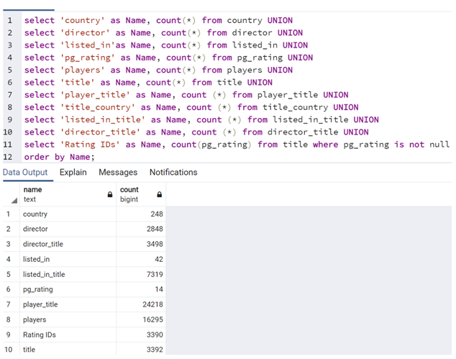
Specific requirements
The project is powered by a data set with at least 24000 records.

Slide 6
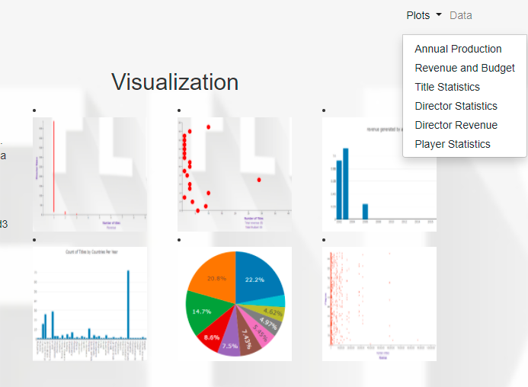
Specific requirements
The project include some level of user-driven interaction. Dropdowns and graphs were implemented.

Slide 7
Challenges
Linking database to Heroku.
Having multiple tables from PostgreSQL and combine them to one json file
Future Plans
Use machine learning to correlate and analyze the data.

